Slide 1

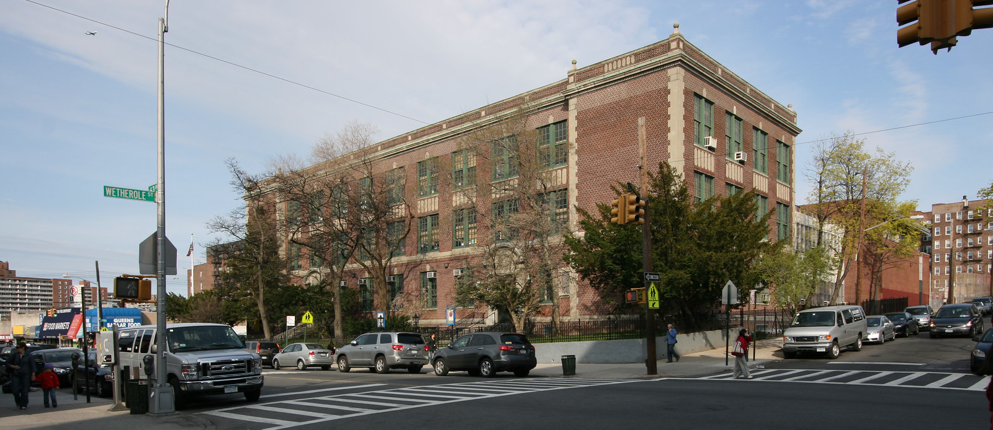
PS 139 REGO PARK

Slide 2
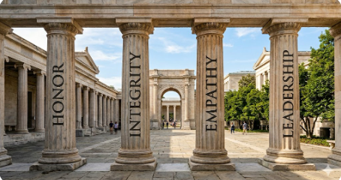
Our Core Values

Slide 3
Who are our Students ?
Total Student Population: 578
Students with Disabilities: 100 (17%)
Multi-lingual Learners: 128 (22%)
Students in Temporary Housing: 59 (10%)
Immigrants: 58 (10%)
Notes:
Languages represented

Slide 4
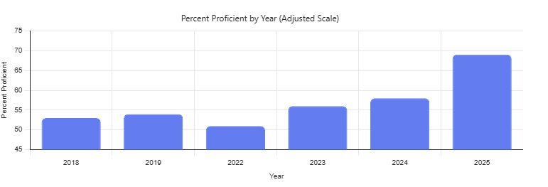
Academics – English Language Arts
Year | Proficiency Levels
2018 | 53%
2019 | 54%
2022 | 51%
2023 | 57%
2024 | 58%
2025 | 68%

Slide 5
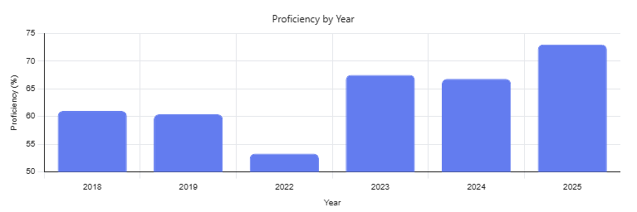
Academics – Math
Year | Proficiency Levels
2018 | 61%
2019 | 61%
2022 | 54%
2023 | 67%
2024 | 67%
2025 | 73%

Slide 6
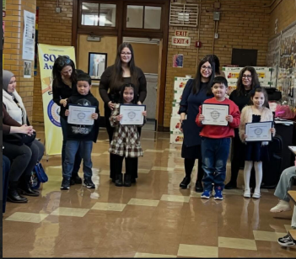


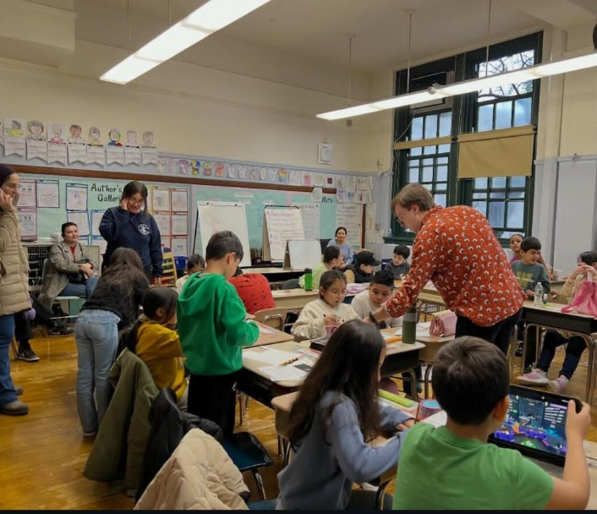
Recognizing Excellence

Slide 7
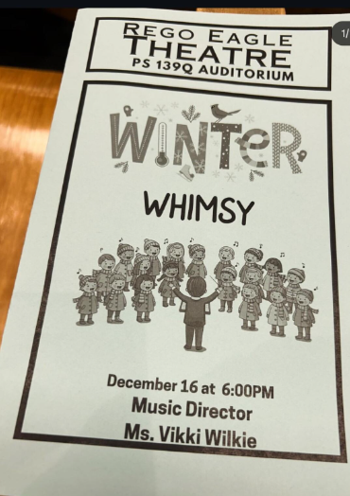
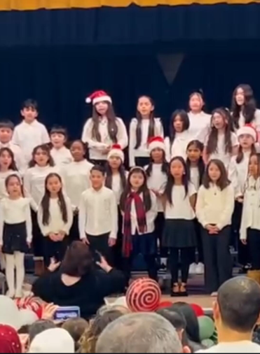
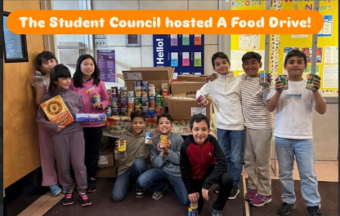
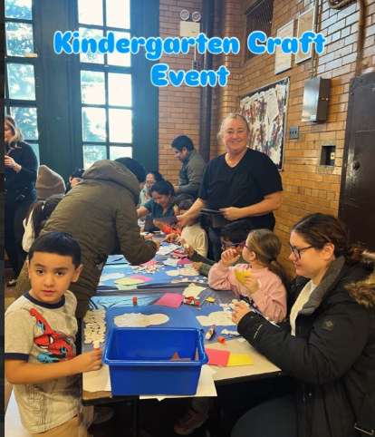
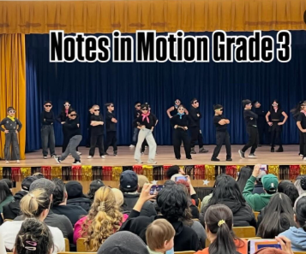
Life Beyond the Classroom…
Saturday Academies – ENL, STH
Arts Programs / Concerts
Rego Eagles in the Community
bc15d

Slide 8
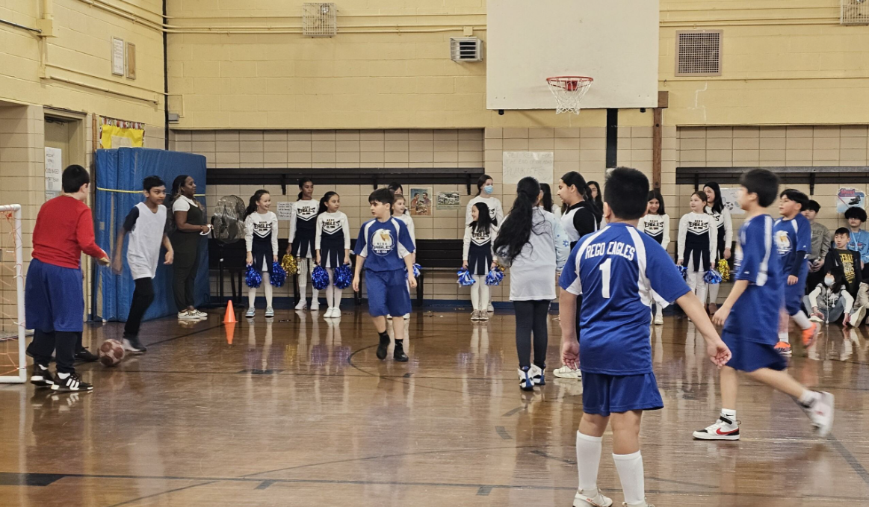
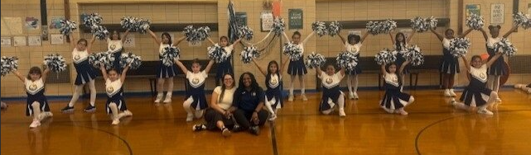
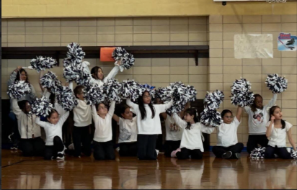
Sports Clubs
CHAMPS after school program– Volleyball, Flag Football
Rego Eagles Basketball Team
Rego Eagles Soccer Team
Rego Eagles Cheer Squad

Slide 9
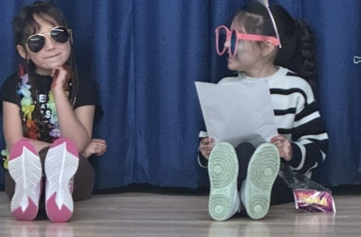
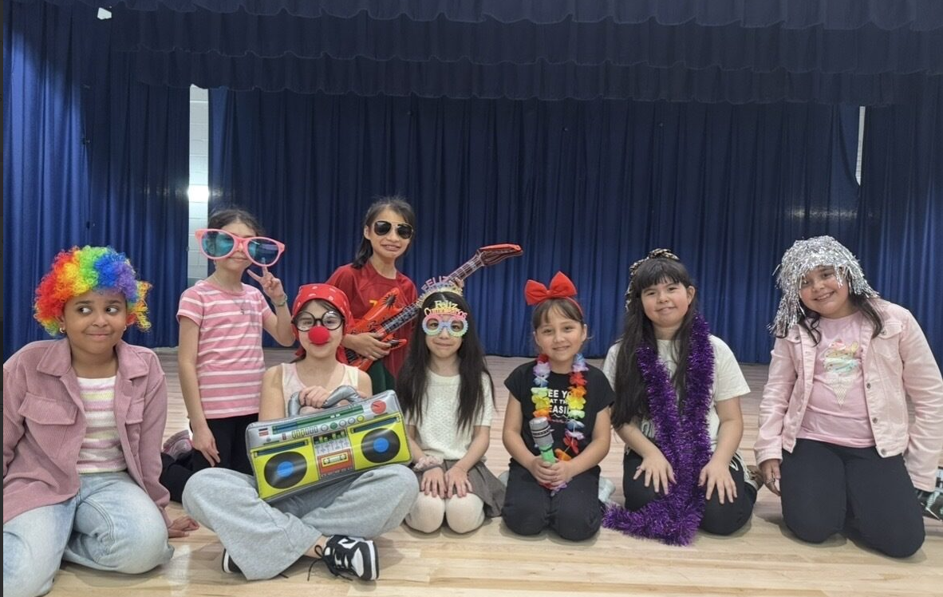
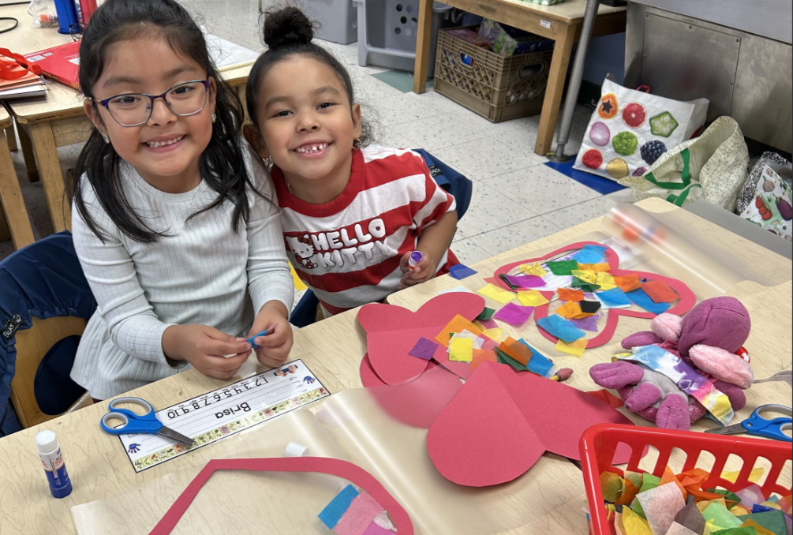
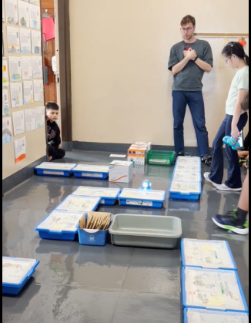
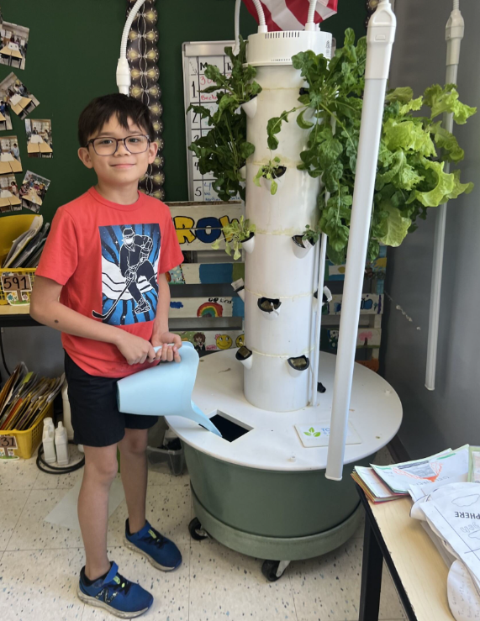
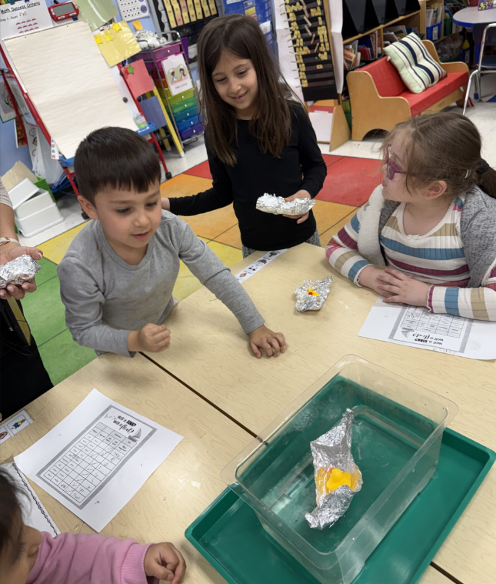
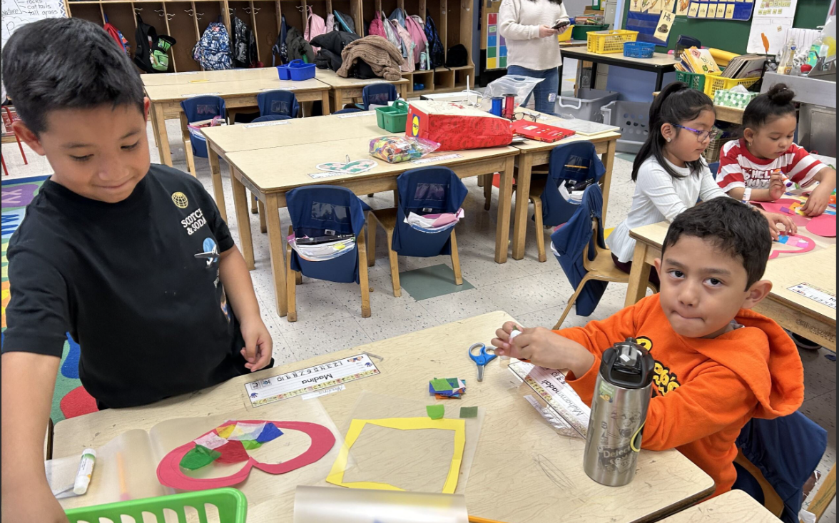
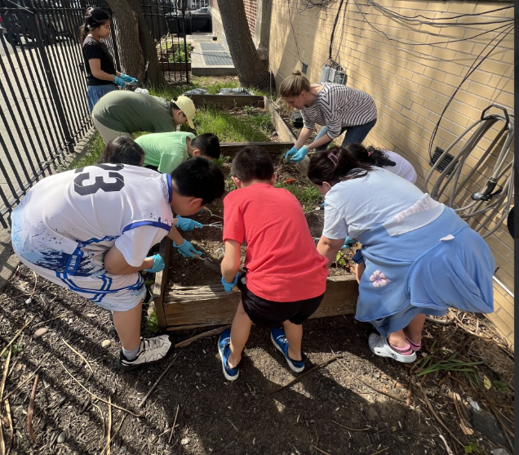
After School Clubs
(Varsity) Cheer Squad
(JV) School Spirit Squad (4 -5)
Modern Dance (3)
Dance / Drama (4-5)
STEAM (K-1)
Robotics (3-5)
Legos (K-1)
Legos (2-3)
Gardening (3-5)
Arts & Crafts (3-5)
Arts & Crafts (K-2)
Puppets (1-2)
Glee Club (4-5_
Jr. Glee Club (2-3)
Archery (2-5)

Slide 10



Our Teachers
Tenured / non tenured: 22 Tenured / 11 Non tenured. Of the tenured, 18 have over 10 yrs exp and 14 have over 20 yrs
Low turnover – teachers that have left PS 139 in the past 6 yrs (3); not including retirements

Slide 11
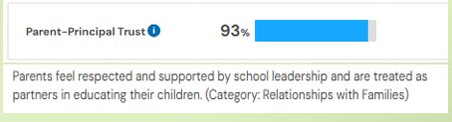
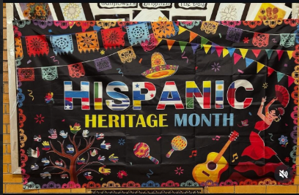

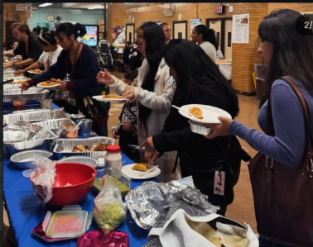
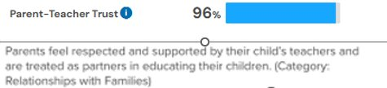

Our Families…
Programs for Parents:
English Classes
Yoga
Nutrition Classes
Parents attending our events (SOAR, Classroom Connections, Concerts, etc…) : Approx 120 per month
PA led events:
Financial Planning
Mothers Day Crafts
Hispanic Heritage Celebration
Valentine’s Day Dance
CPR Training
Book Fair

Slide 12
Thank you!

